Slide 1




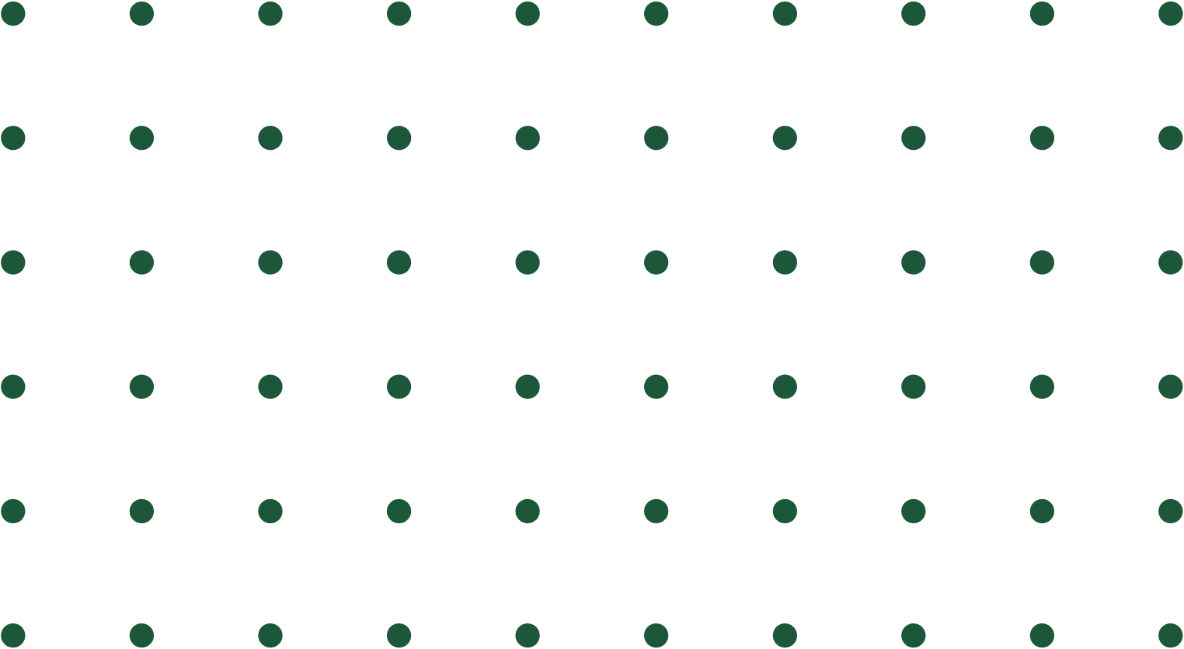
Customer Segmentation & Predictive Modeling for Product Buying Patterns
Presented by Group 6
Ranju Timilsina
Sahil Sood
Sana Yasin
Shinda Sheret
Sindhu Sundararajan
Date: 6/17/2024
Notes:
Good evening, everyone.
We are Team 6—Ranju, Sahil, Sana, Shinda, and myself, Sindhu. Today, we will discuss Customer Segmentation and Predictive Modeling for Product Buying Patterns. Moving to the next slide

Slide 2

CONTENT
Problem Statement
Objectives
Analysis
Exploring Sales
0
Cohort Analysis
RFM Analysis
K-Means Clustering
Market Basket Analysis
Conclusion
Reference
Notes:
We will cover the following topics: the Problem Statement, Objectives, Analysis (including Exploring Sales, Cohort Analysis, RFM Analysis, K-Means Clustering, and Market Basket Analysis), and finally, our Conclusion. Moving to the next slide

Slide 3





PROBLEM STATEMENT
01
Identify customer buying patterns to understand and map out the purchasing behaviors.
Develop Models to segment customers to determine unique needs of each group.
02
Also segment them for potential bundling opportunities.
03
Determine the churn rate and measures to prevent it and for targeted marketing efforts.
04
Notes:
Our goal is to identify customer buying patterns to understand and map out purchasing behaviors. We aim to develop models to segment customers, determining the unique needs of each group. Additionally, we will segment customers to identify potential bundling opportunities. Furthermore, we will determine the churn rate and devise measures to prevent it, enabling more effective targeted marketing efforts. Moving to the next slide

Slide 4






OBJECTIVES
Identify and Analyze Customer Buying Patterns
Understand and map out the purchasing behaviors and trends of customers over time.
Segment Customers Based on Behavioral Data
Classify customers into distinct segments based on their purchasing behavior and engagement with the brand.
Identify Potential Bundling Opportunities
Discover complementary products that can be bundled together to increase sales and enhance customer satisfaction.
Predict Customer Churn and Develop Retention Strategies
Determine the factors leading to customer churn and create predictive models to identify at-risk customers.
Notes:
Objectives: We have 4 objectives
First one is Identify and Analyze Customer Buying Patterns
- Understand and map out customers' purchasing behaviours and trends over time by analyzing their transaction data, preferences, and buying frequency. The second one is
Segment Customers Based on Behavioral Data
- By grouping customers with similar behaviors, we can tailor marketing efforts and product recommendations to meet the specific needs of each segment.
The third one is
Identify Potential Bundling Opportunities
- By identifying products that are frequently purchased together, we can create attractive bundle offers that provide added value to customers while boosting our sales.
The fourth one is
Predict Customer Churn and Develop Retention Strategies
- By understanding why customers leave, we can develop targeted retention strategies and proactive measures to reduce churn and improve customer loyalty. Sahil will explain EDA.

Slide 5

EXPLORATORY DATA ANALYSIS

Slide 6


VALUE METRICS AND GROUPS
PRH4 products categorized as Instruments and Accessories, Implants, Prosthetics and Restorative Solutions, Surgical and Healing Products, Abutments, Miscellaneous, Unknown, Software and Services.
Order Count
Number of orders
Customer Count
Number of Customers
Customers categorized as Academic Institutions, Clinical Practitioners, Laboratories, Other, Healthcare Facilities, Specialized Roles, Government and Military, Business Entities, Employee, Others.
AOV: Average Order Value
Average value of an order placed
ACV: Average Customer Value
Average spend by a buyer group

Slide 7
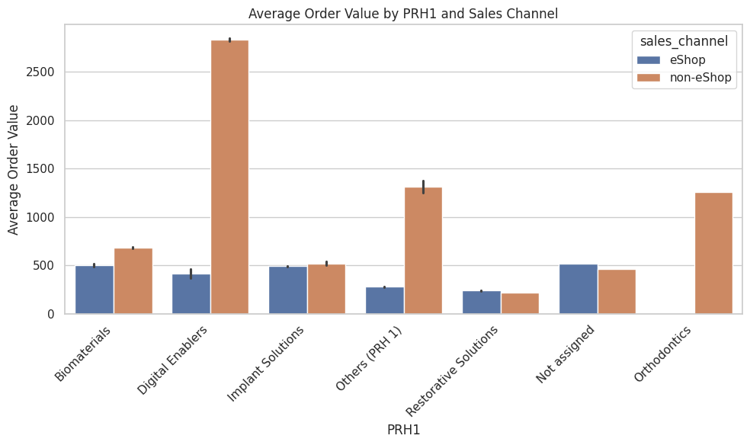
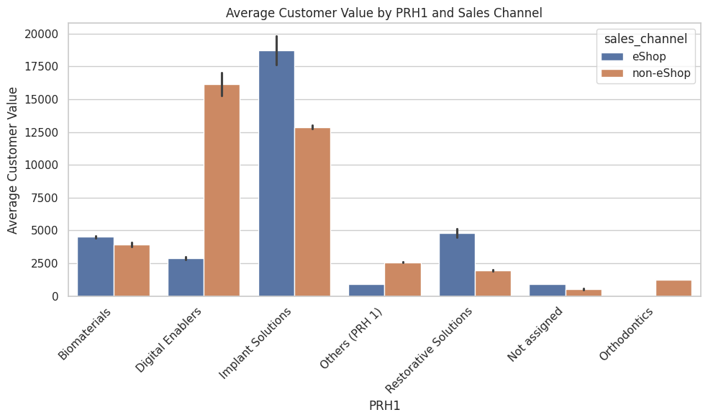
AVERAGE ORDER VALUE BY PRH1 AND SALES CHANNEL

Slide 8
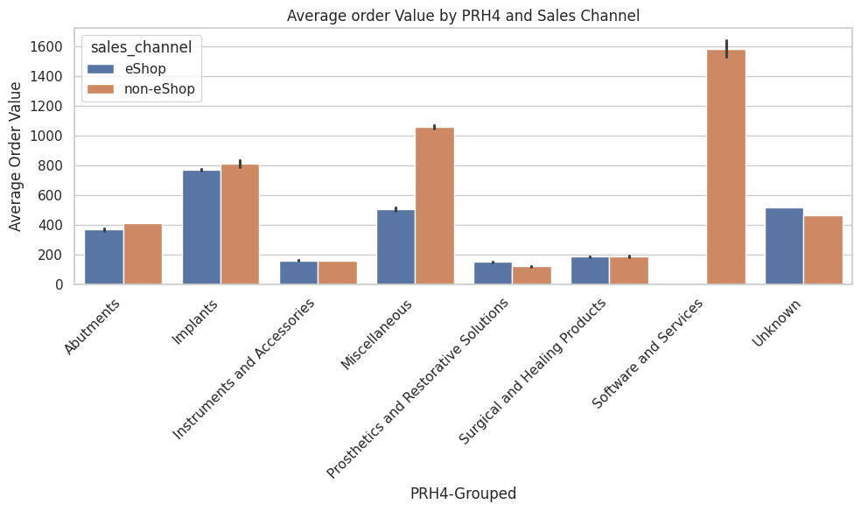
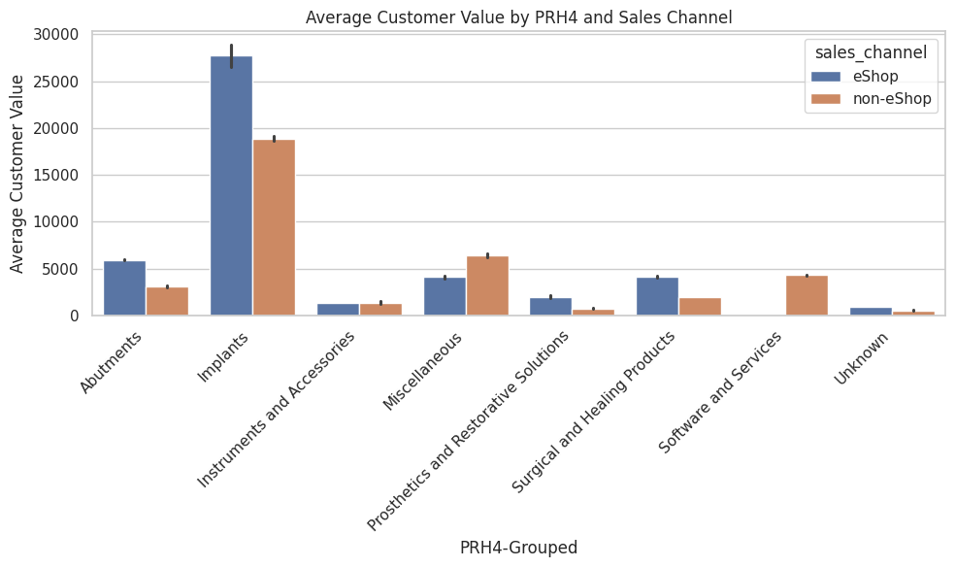
ACV/AOV BY PRH4 AND SALES CHANNEL

Slide 9
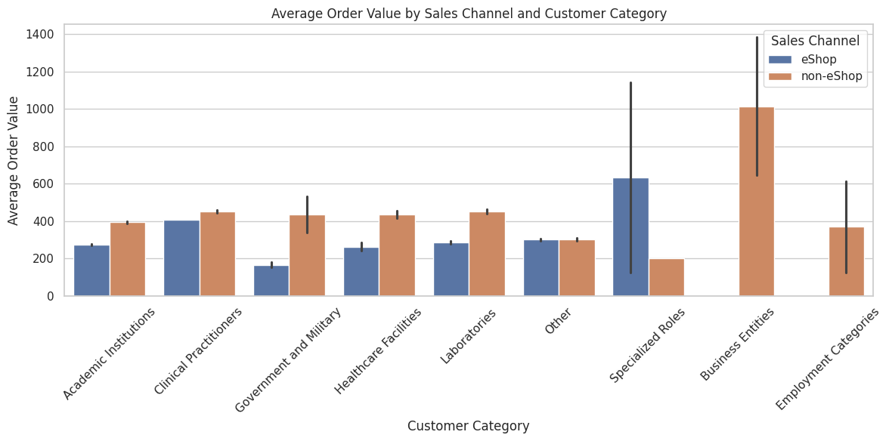
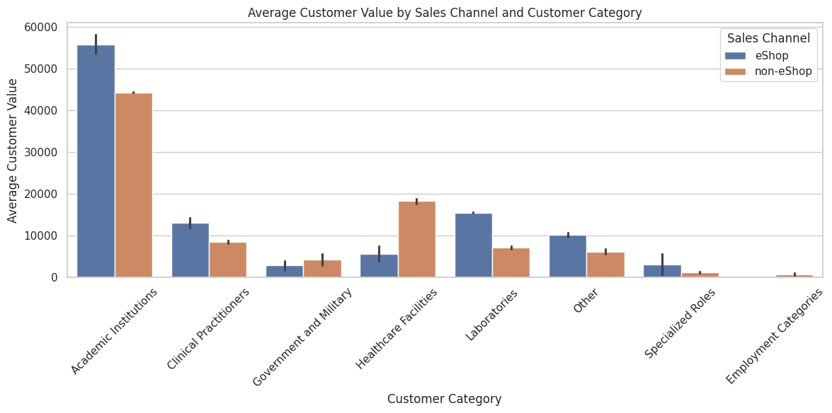
ACV/AOV BY CHANNEL AND GROUP
Notes:
Business entities group has 1 customer accounting for higher ACV & AOV. Redacted from the graph to show
scale of other categories

Slide 10
COHORT ANALYSIS

Slide 11
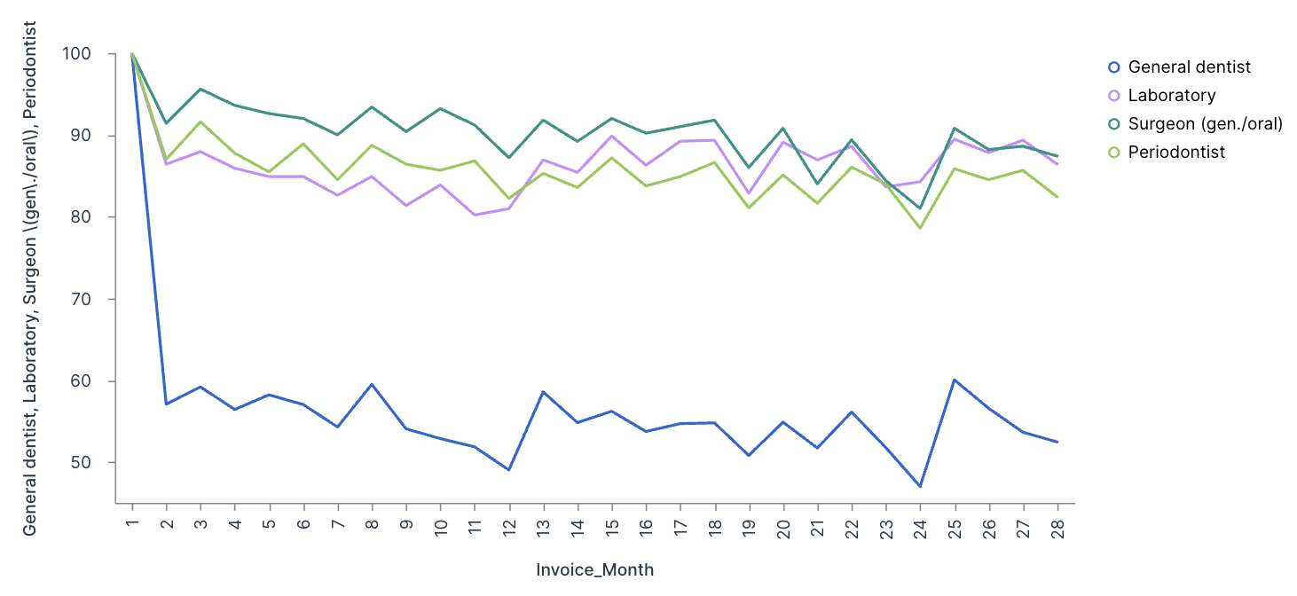
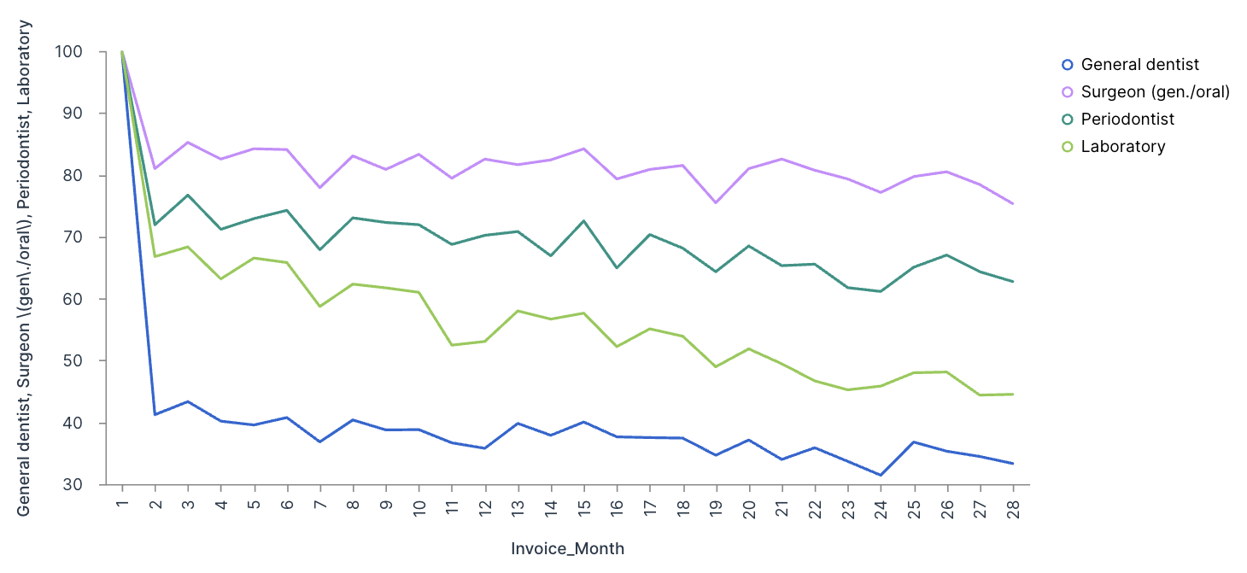
ESHOP AND NON-ESHOP ANALYSIS
ESHOP
NON-ESHOP

Slide 12
RFM ANALYSIS

Slide 13

RFM VALUE TABLE
Groups | Recency (days) | Frequency | Monetary (in USD) | No of Customers
GOLD | 20.29 | 55.43 | 82338.75 | 14225
SILVER | 178.97 | 5.62 | 4001.30 | 38031
BRONZE | 503.27 | 1.32 | 198.38 | 16549

Slide 14
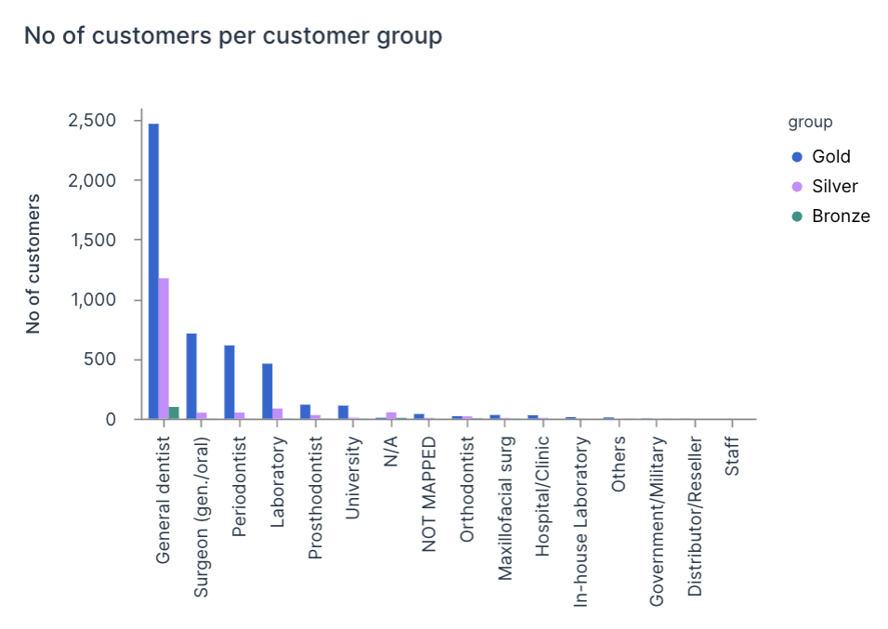
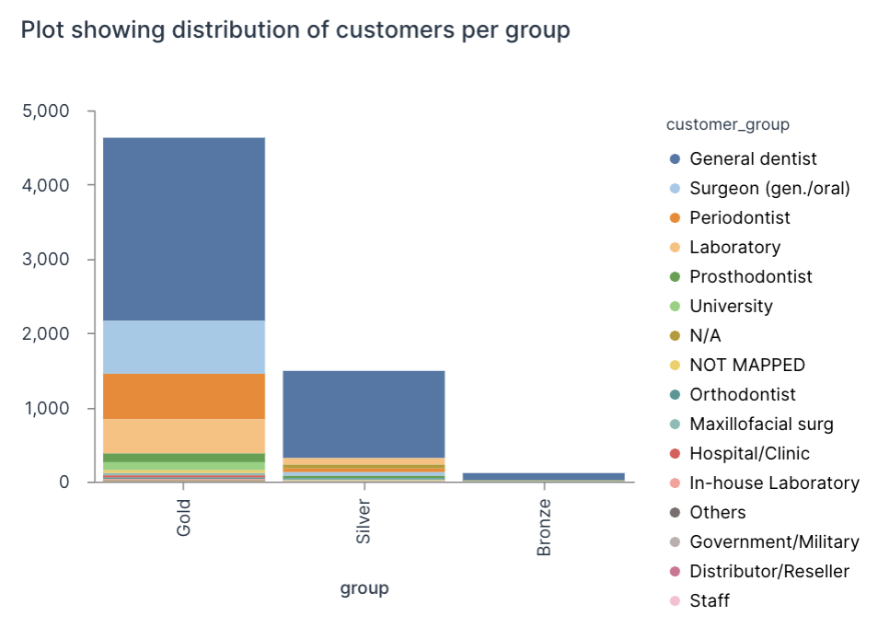
RFM ANALYSIS VISUALIZATIONS

Slide 15
K-MEANS CLUSTERING FROM RFM ANALYSIS

Slide 16

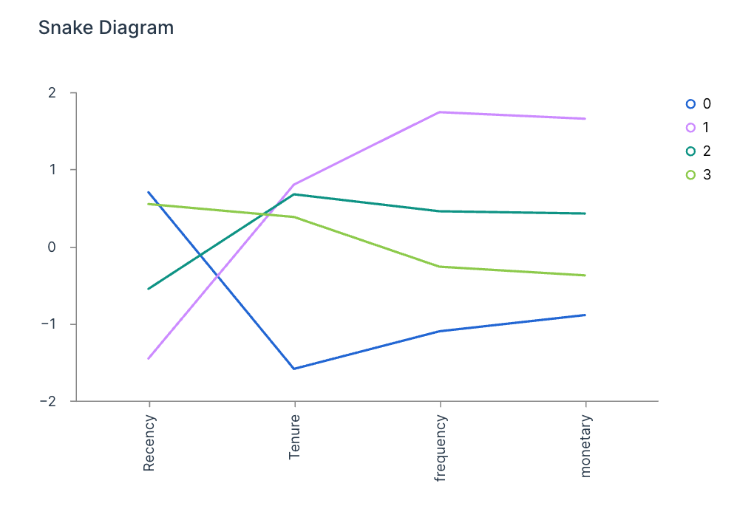
CLUSTERING USING RFM
Remy
Marsh
Everest Cantu
Drew Holloway
Morgan Maxwell
Manager
Marketing
Business Head
Manager

Slide 17
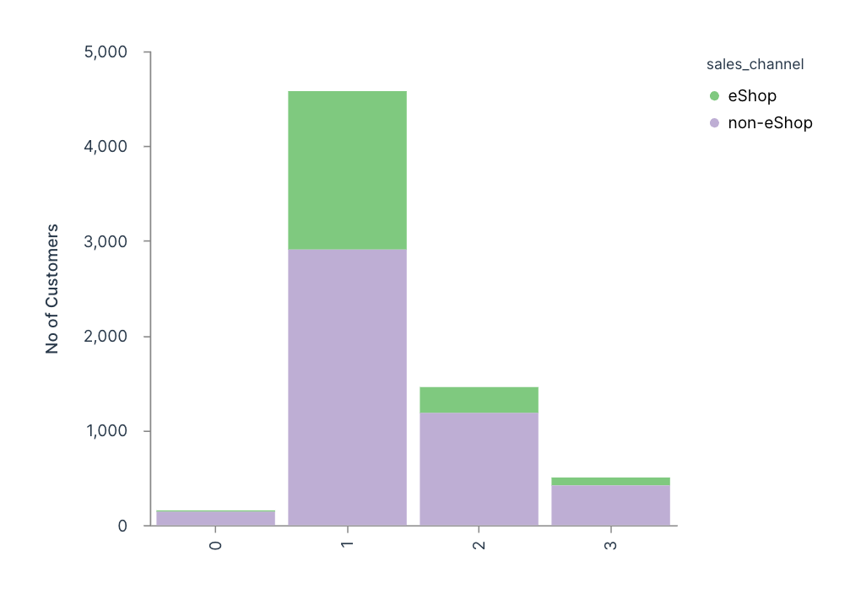
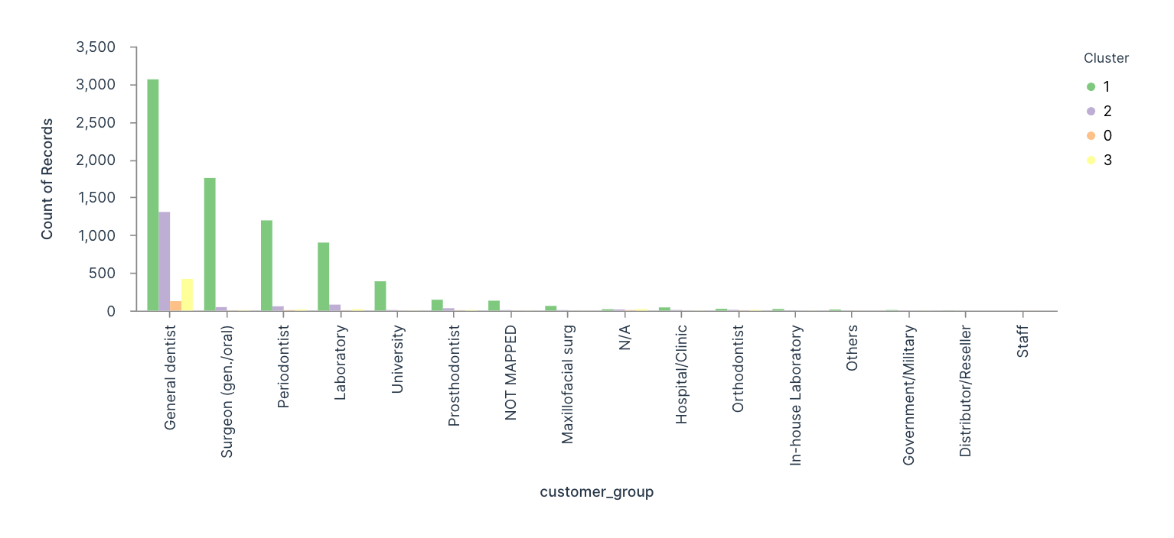
CLUSTERING BASED ON CUSTOMER GROUP AND SALES CHANNEL
Remy
Marsh
Everest Cantu
Drew Holloway
Morgan Maxwell
Manager
Marketing
Business Head
Manager

Slide 18
MARKET BASKET ANALYSIS

Slide 19
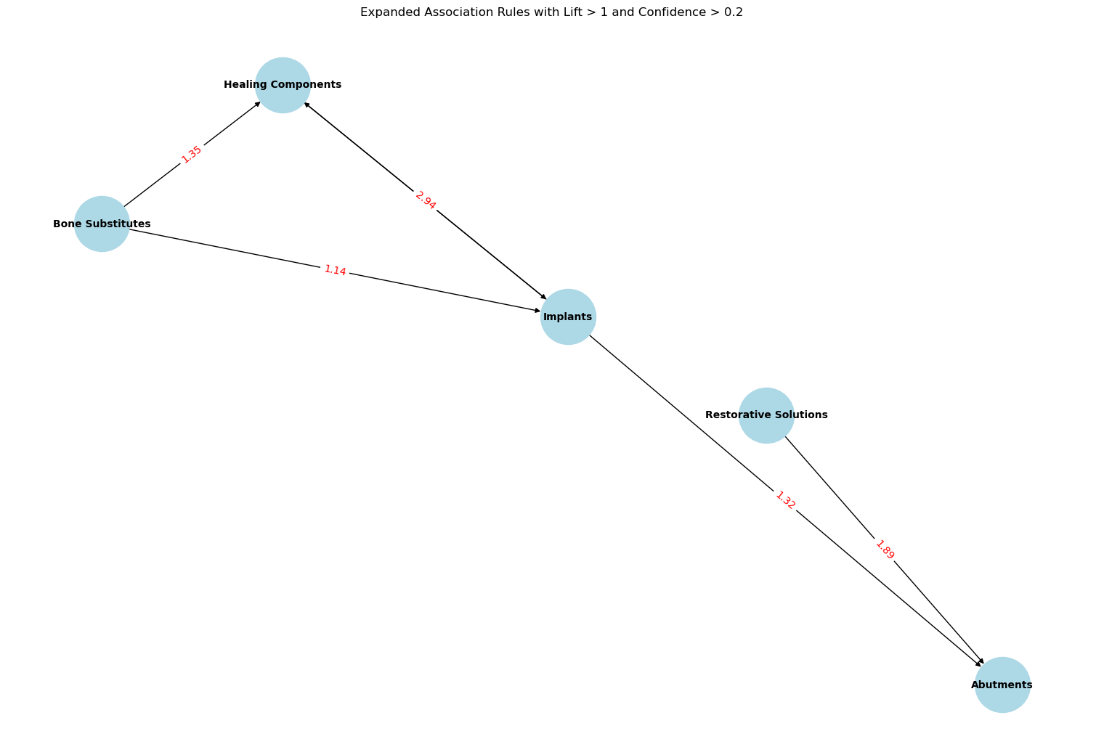
Visualizing Market Basket Analysis: Expanded Association Rules with Lift and Confidence Metrics
Remy
Marsh
Everest Cantu
Drew Holloway
Morgan Maxwell
Manager
Marketing
Business Head
Manager

Slide 20

Visualizing Market Basket Recommendations with Word Clouds
Remy
Marsh
Everest Cantu
Drew Holloway
Morgan Maxwell
Manager
Marketing
Business Head
Manager

Slide 21


CONCLUSION
e-Shop as a Key Channel: The e-Shop platform plays a crucial role in customer retention and generating higher average order values.
Targeted Marketing Strategies: Leveraging insights from cohort and cluster analyses, targeted marketing efforts can be developed to enhance customer retention, particularly for valuable customer segments identified in Cluster 2.
Product Bundling Opportunities: Identifying complementary products through market basket analysis can lead to effective bundling strategies, driving higher order values and improving customer satisfaction.
Retention and Loyalty Enhancement: Focused retention strategies, especially for general dentists and other high-value customer groups, are essential to sustain long-term loyalty and revenue growth.

Slide 22
REFERENCES
Tavakoli, M., Ghanavati-Nejad, M., Tajally, A., & Sheikhalishahi, M. (2023, May 8). LRFM- based association rule mining for dentistry services patterns identification (Case study: a dental center in Iran). https://doi.org/10.21203/rs.3.rs-2139952/v1
Bohorquez, N. (2021, August 26). Cohort Analysis with Python&#8217;s matplotlib, pandas, numpy and datetime. ActiveState. https://www.activestate.com/blog/cohort-analysis-with-python/
Straumann Group. (n.d.). https://www.straumann.com/
Mangano, F., Masunda, D., Napoletano, S., & Admakin, O. (2021). The future of dental implant surfaces: A biomimetic surface with regenerative and anti-infection properties. Frontiers in Bioengineering and Biotechnology, 9, 653305. https://doi.org/10.3389/fbioe.2021.653305
Kushal, S., Kumari, P., & Mehta, N. (2020). Customer segmentation in healthcare using clustering techniques: A survey. International Journal of Intelligent Engineering & Systems, 13(6), 243-256. https://doi.org/10.22266/ijies2020.1231.22

Slide 23
THANK YOU

